Slide 1



Wardiere, Inc.
Home
About
Content
Others
Mini-HPC & Hybrid Big Data Clusters for Bioinformatics ML
Distributed Machine Learning with MPI and Spark
Dana Mohamed 221000946
Ahmed Hamdy 221001876
Wardiere, Inc.
-
Computer
-
Presentation 2024

Slide 2


Wardiere, Inc.
Home
About
Content
Others
project overview
Understand HPC and Big Data fundamentals.
Deploy a virtual 3-node cluster (1 master + 2 workers).
Implement distributed ML with MPI (Task 1).
Set up Docker Swarm and Spark ML pipeline (Task 2).
Run bioinformatics gene expression analysis using Spark.
Wardiere, Inc.
-
Computer
-
Presentation 2024

Slide 3

Wardiere, Inc.
Home
About
Content
Others
technologies used
MPI, MPI4PY
APACHE SPARK & PYSPARK
Strategic consulting to optimize IT infrastructure.
Advanced AI solutions to enhance business operations.
DOCKER SWARM
GOLUB GENE EXPRESSION DATASET
Comprehensive security services to protect digital assets.
Custom software solutions tailored to client needs.
JUPYTER NOTEBOOK
Wardiere, Inc.
-
Computer
-
Presentation 2024

Slide 4

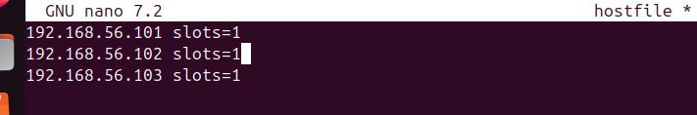
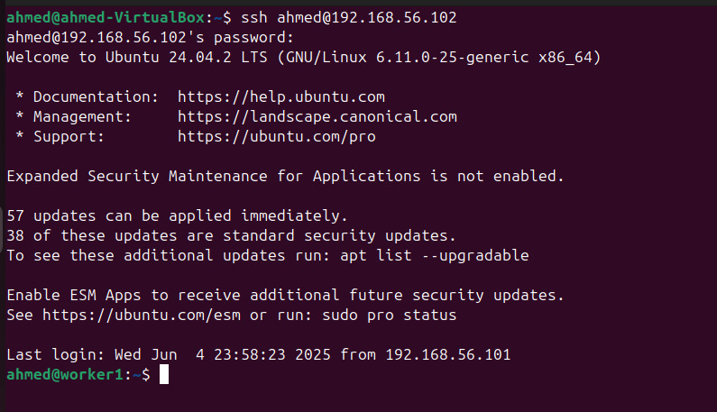
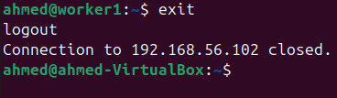
Wardiere, Inc.
Task 1
Mini-HPC Cluster
Home
About
Content
Others
Built using VirtualBox with 3 VMs.
Configured passwordless SSH
.
Installed MPI and mpi4py.
Ran distributed ML on the Digits dataset.
Used
distributed_mnist.py
-
Computer
-
Presentation 2024

Slide 5

Wardiere, Inc.
Home
About
Content
Others
Task 1
Bioinformatics ML with MPI
Dataset: distributed_covid_classification.py
Used OpenMPI for parallel
gene analysis Script: distributed_gene_analysis.py
MPI Implementation
· Training Time: ~0.05s (average per process)
· Test Accuracy: ~67%
· Ensemble Method: Majority voting
· Scalability: Linear speedup with more ranks
-
-
Wardiere, Inc.
Computer
Presentation 2024

Slide 6
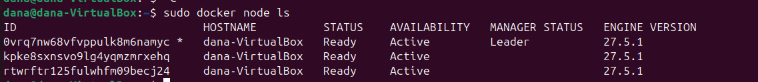

Wardiere, Inc.
Home
About
Content
Others
TASK 2
DOCKER SWARM SPARK CLUSTER
Initialized Docker Swarm.
Deployed Spark with spark-stack.yml.
Connected 3 nodes into a Swarm cluster.
Verified Spark UI for job monitoring.
-
-
Wardiere, Inc.
Computer
Presentation 2024

Slide 7
Wardiere, Inc.
Home
About
Content
Others
TASK 2
DISTRIBUTED GENE EXPRESSION WITH SPARK
Used distributed_gene_expression_analysis.py.
Ran PySpark ML on gene expression data.
Evaluated distributed ML performance.
Spark Implementation Results
Training Time: ~15–20 seconds (including distributed overhead)
Test Accuracy: ~65–70% (improved with automated feature selection)
Features: Reduced from 21 to 15 using ChiSqSelector in a pipeline
Advantage: Efficient handling of larger structured datasets with scalable parallel executions
-
-
Wardiere, Inc.
Computer
Presentation 2024

Slide 8

Wardiere, Inc.
Home
About
Content
Others
CHALLENGES & LESSONS LEARNED
VM networking and resource constraints.
Debugging MPI/Spark communication issues.
Learned hands-on cluster deployment and ML
Wardiere, Inc.
-
Computer
-
Presentation 2024

Slide 9

Wardiere, Inc.
Home
About
Content
Others
FINAL OUTCOMES
Built a functioning hybrid HPC cluster.
Ran distributed ML on real datasets.
Demonstrated containerized Spark ML workflows.
Gained practical experience with HPC tools
Wardiere, Inc.
-
Computer
-
Presentation 2024

Slide 10
Wardiere, Inc.
Home
About
Content
Others
THANK YOU
Wardiere, Inc.
-
Computer
-
Presentation 2024

